Slide 1

GRAPH THEORY AND ITS APPLICATIONS
Dr. Arti Arya
Department of Computer Science & Engineering

Slide 2

Graph Theory and its Applications Disclaimer
The slides are prepared by Dr. Surabhi Narayan and a lot of content is added by Dr. Arti Arya. The sources of the information other than text book is mentioned wherever used.

Slide 3
GRAPH THEORY AND ITS APPLICATIONS
EULERIAN GRAPHS
Dr. Arti Arya
Department of Computer Science & Engineering

Slide 4
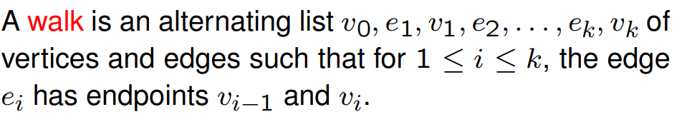
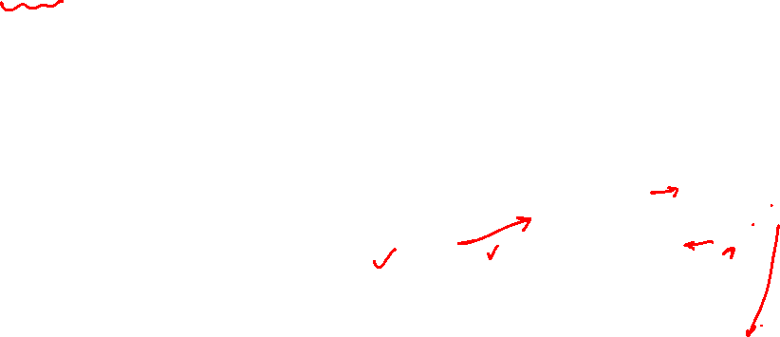
Graph Theory and its Applications Walk, Path, circuits
Walk
A walk in the graph G=(V,E) is a finite sequence of the form
v_{i0}, e_{j1}, v_{i1}, e_{j2}, ……. e_{jk}, v_{ik}
v₂
e₂
v₃
e₁
v₁
e₈
e₇
e₃
e₅
^{e}10
e
9
v₅
e₆
v₄
e₄
v₆

Slide 5
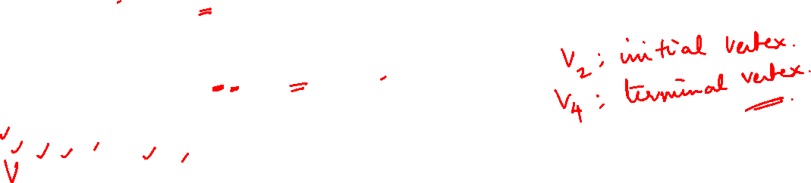
Graph Theory and its Applications Walk, Path, circuits
Walk
v₂
e₂
v₃
e₁
v₁
e₈
e₇
e₃
e₅
^{e}10
e
9
v₅
e₆
v₄
e₄
v₆
_{V2} e₇ v₅ e₈ v₁ e₈ v₅ e₆ v₄ e₅ v₄ is an open walk
v_{i0} and v_{ik} are the end vertices.
v_{i0} is the initial vertex and v_{ik} is the terminal vertex K is the length of the walk

Slide 6

Graph Theory and its Applications Walk, Path, circuits
Walk
v₂
e₂
v₃
e₁
v₁
e₈
e₇
e₃
e₅
^{e}10
e
9
v₅
e₆
v₄
e₄
v₆
V₂ e₇ v₅ e₈ v₁ e₈ v₅ e₆ v₄ e₅ v₄ is an open walk whereas v₄ e₅ v₄ e₃ v₃ e₂ v₂ e₇ v₅ e₆ v₄ is a closed walk

Slide 7


Graph Theory and its Applications Walk, Path, circuits
Trail
v₂
e₂
v₃
e₁
v₁
e₈
e₇
e₃
e₅
^{e}10
e
9
v₅
e₆
v₄
e₄
v₆
A walk is a trail if edges of the walk are traversed at most once
V₁ e₈ v₅ e₉ v₁ e₁ v₂ e₇ v₅ e₆ v₄ e₅ v₄ e₄ v₄ is a trail.

Slide 8

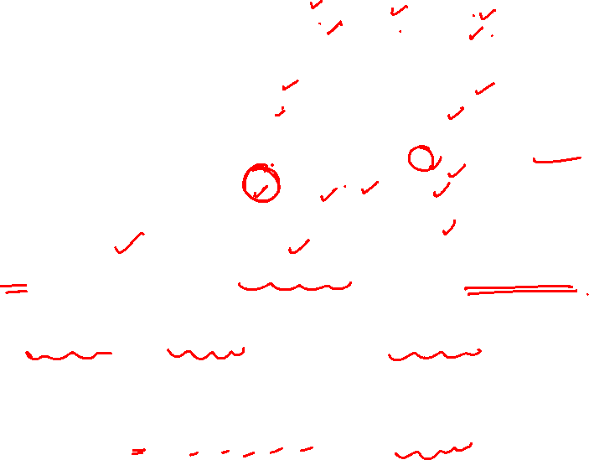
Graph Theory and its Applications Walk, Path, circuits
Path
v₂
e₂
v₃
e₁
v₁
e₈
e₇
e₃
e₅
^{e}10
e
9
v₅
e₆
v₄
e₄
v₆
A trail is a path wherein vertices are visited at most once.
v₂ e₇ v₅ e₆ v₄ e₃ v₃ is a path.
A closed trail is a circuit whereas a closed path is a cycle. V₅ e₇ v₂ e₂ v₃ e₃ v₄ e₄ v₄ e₆ v₅ is a circuit
whereas
v₅ e₇ v₂ e₂ v₃ e₃ v₄ e₆ v₅ is a cycle.

Slide 9
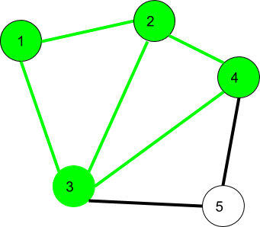
Graph Theory and its Applications Walk, Path, circuits
Walk
$$1→2→3→4→2→1→3 is a walk$$

Slide 10


Graph Theory and its Applications Walk, Path, circuits
Walk
$$1→2→3→4→2→1→3 is an open walk$$
$$1→3→2→4→3→2→1 is a closed walk$$

Slide 11
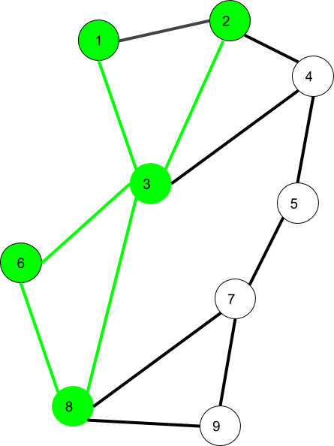
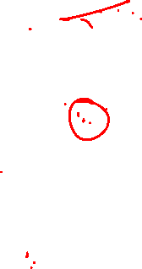
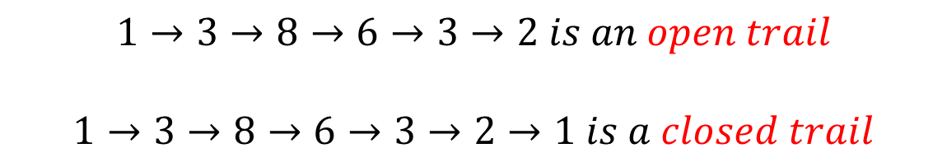
Graph Theory and its Applications Walk, Path, circuits
Trail
$$1→3→8→6→3→2 is an open trail$$
$$1→3→8→6→3→2→1 is a closed trail$$

Slide 12
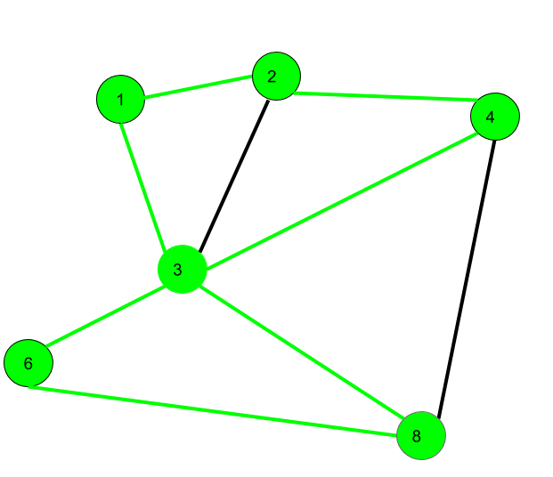
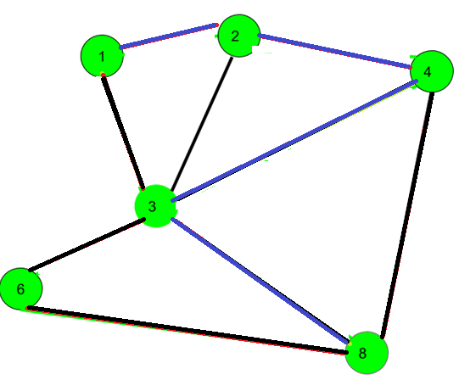
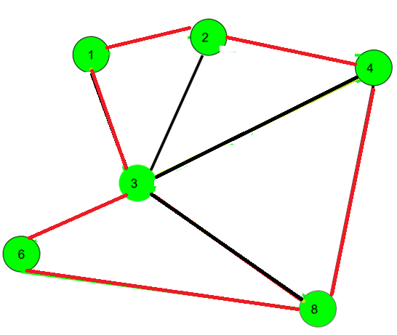
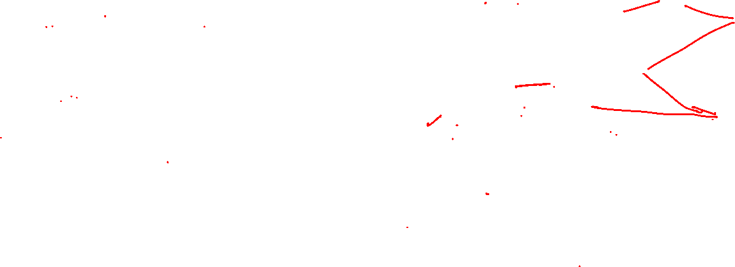
Graph Theory and its Applications Walk, Path, circuits
Path, Circuit and Cycle
$$1→2→4→3→8→6 is a path.$$
$$1→2→4→3→8→6→3→1 is a circuit$$
$1→2→4→8→6→3→1$ is a cycle
https://www.geeksforgeeks.org/mathematics-walks-trails-paths-cycles-and-circuits-in-graph/

Slide 13
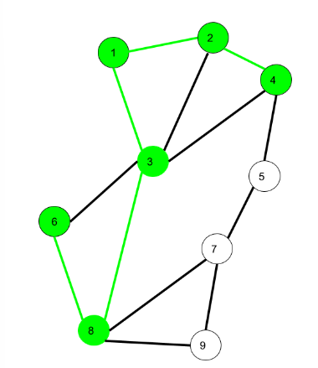
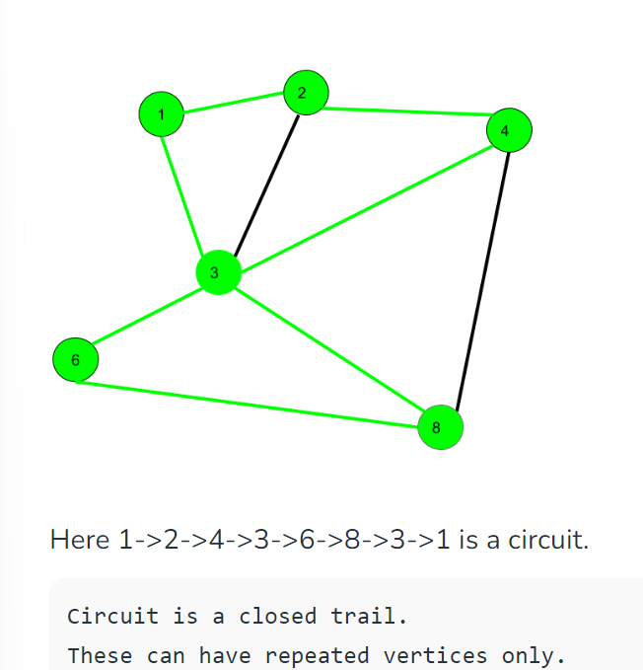
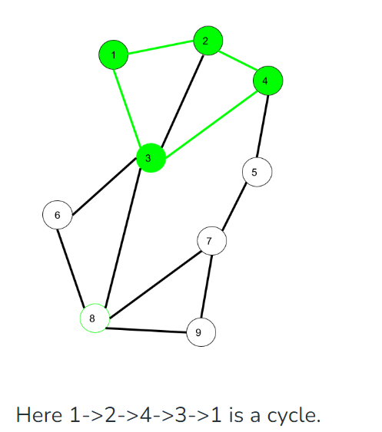
Graph Theory and its Applications Walk, Path, circuits
Path, Circuit and Cycle
Here 6->8->3->1->2->4 is a Path (
Vertex and Edge not repeated)
https://www.geeksforgeeks.org/mathematics-walks-trails-paths-cycles-and-circuits-in-graph/

Slide 14
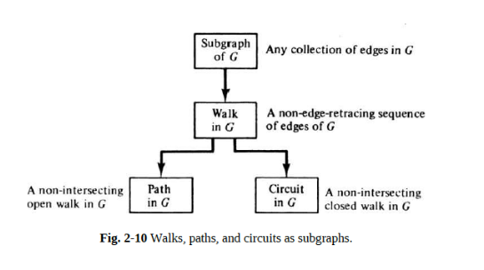
Graph Theory and its Applications Walk, Path, circuits
Path, Circuit and Cycle

Slide 15
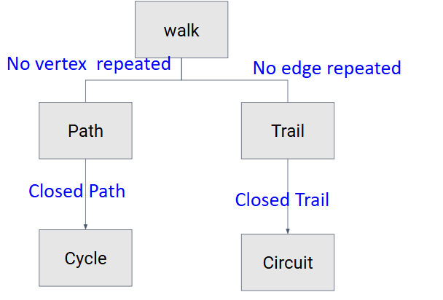

Graph Theory and its Applications Walk, Path, circuits
Path, Circuit and Cycle

Slide 16
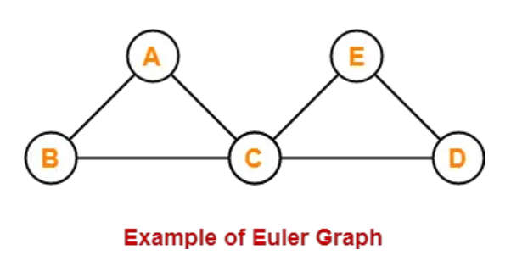
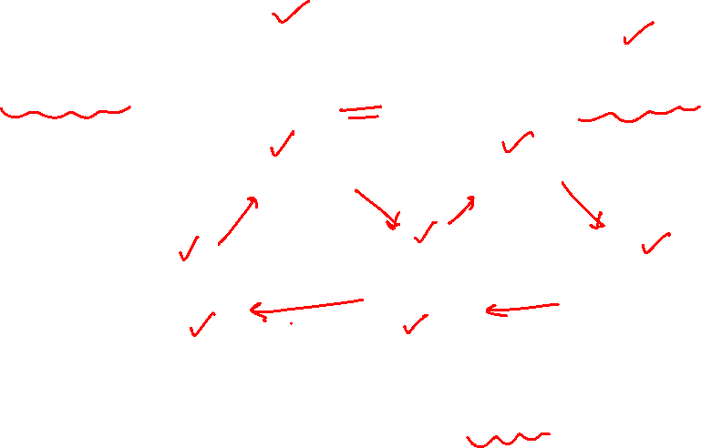
Graph Theory and its Applications Walk, Path, circuits
Eulerian Graph
Euler Graph - A connected graph G is called a Euler graph, if there is a closed trail (circuit) which includes every edge of the graph G.
The above graph contains an Euler circuit BACEDCB, so it is an Euler graph

Slide 17
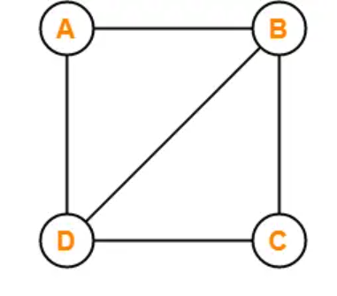
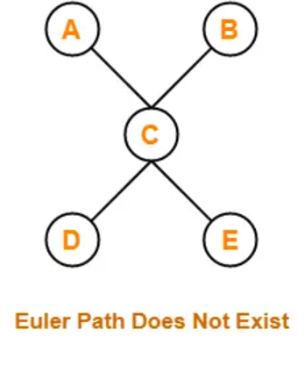

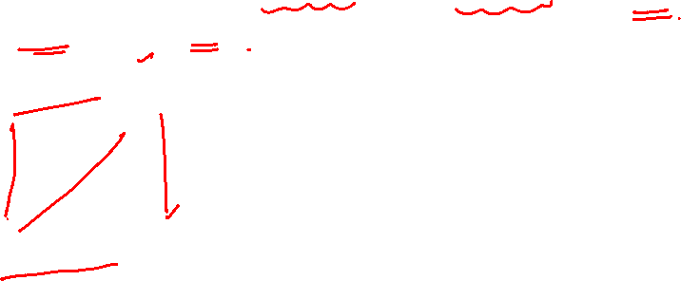
Graph Theory and its Applications Walk, Path, circuits
Eulerian Graph
Euler Path (Euler path is also known as Euler Trail or Euler Walk). - A Euler path is a path that uses every edge of a graph exactly once. A Euler path starts and ends at different vertices.

Slide 18
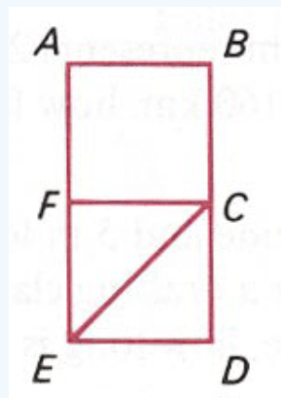
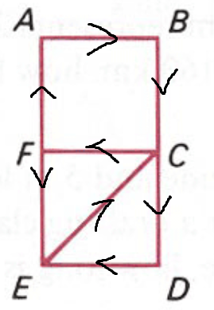
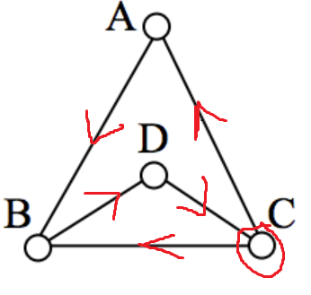
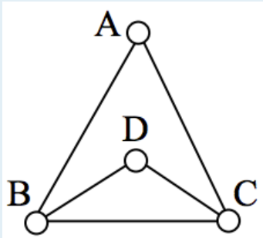
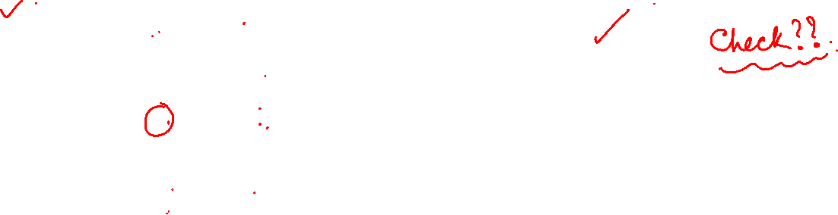
Graph Theory and its Applications Walk, Path, circuits
Eulerian Graph
Euler Path (Euler path is also known as Euler Trail or Euler Walk). - A Euler path is a path that uses every edge of a graph exactly once. A Euler path starts and ends at different vertices.

Slide 19
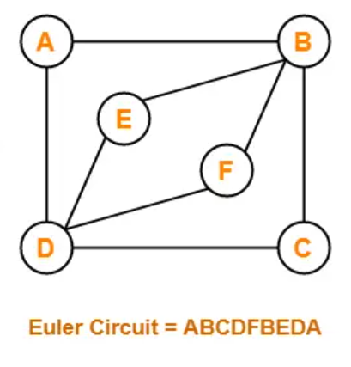
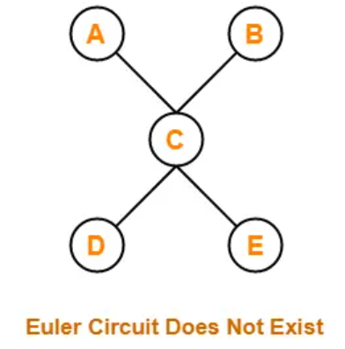
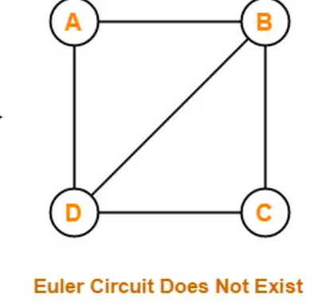
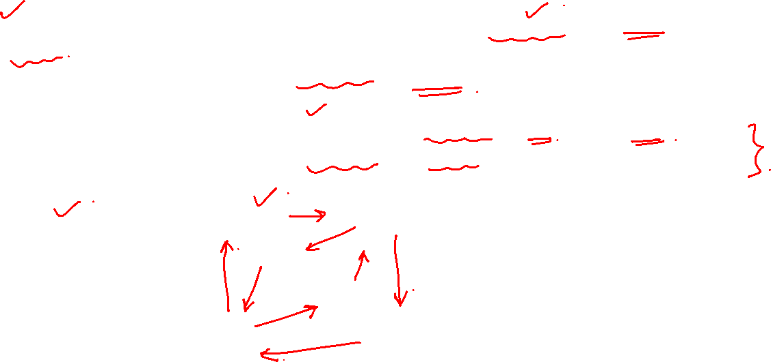
Graph Theory and its Applications
Walk, Path, circuits
Euler Circuit - A Euler circuit is a circuit that uses every edge of a graph exactly once. (Eulerian circuit is a Eulerian path which starts and ends on the same vertex.). A Euler circuit always starts and ends at the same vertex.
A connected graph G is a Euler graph iff all vertices of G are of even degree, and a connected graph G is Eulerian iff its edge set can be decomposed into cycles.

Slide 20
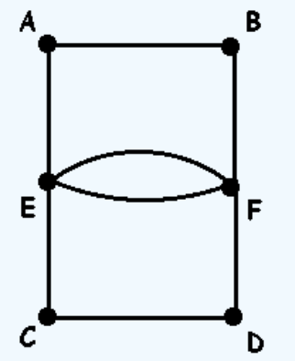
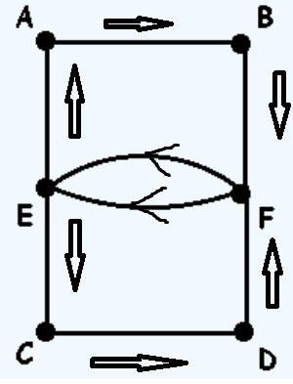
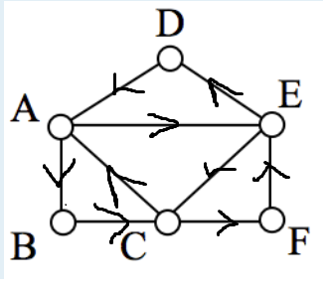
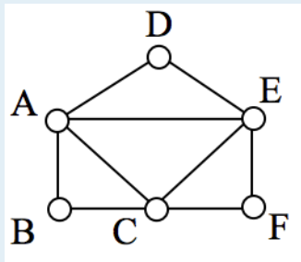

Graph Theory and its Applications Walk, Path, circuits
Euler Circuit - A Euler circuit is a circuit that uses every edge of a graph exactly once. A Euler circuit always starts and ends at the same vertex.
A connected graph G is a Euler graph iff all vertices of G are of even degree, and a connected graph G is Eulerian iff its edge set can be decomposed into cycles.
E C D F E A B F E
A B C F E D A E C A

Slide 21
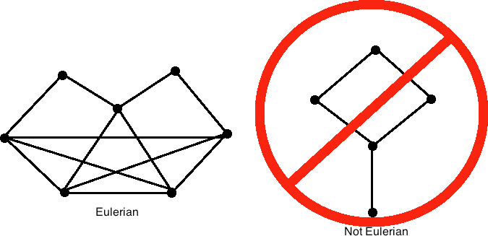
Graph Theory and its Applications Walk, Path, circuits
7
8
9
10
1
2
4
3
5
6
11
12
http://mathonline.wikidot.com/eulerian-graphs-and-semi-eulerian-graphs

Slide 22
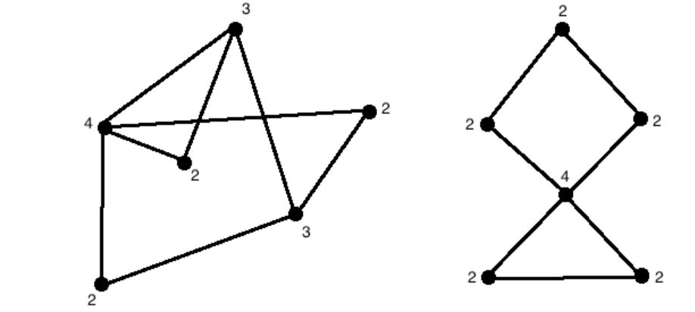

Graph Theory and its Applications Walk, Path, circuits
Whether Eulerian or not?
Not Eulerian as there are two vertices with odd degree,
Eulerian since each vertex has an even degree.
http://mathonline.wikidot.com/eulerian-graphs-and-semi-eulerian-graphs

Slide 23
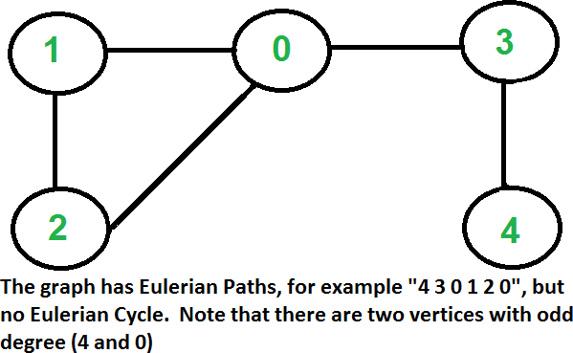
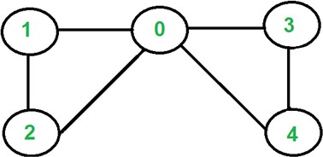

Graph Theory and its Applications Walk, Path, circuits
The graph has Euler circuit but not Euler cycle. Note that all vertices are of even degree
A graph is called Eulerian if it has a Eulerian Circuit and called Semi-Eulerian if it has a Eulerian Path.

Slide 24
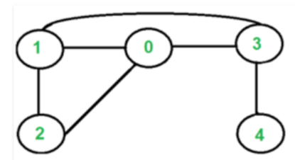

Graph Theory and its Applications Walk, Path, circuits
Not Eulerian bcoz there are 4 vertices with odd degree.
A graph is called Eulerian if it has a Eulerian Circuit and called Semi-Eulerian if it has a Eulerian Path.

Slide 25
Graph Theory and its Applications Euler’s Graph
Euler Graph - A connected graph G is called a Euler graph, if there is a closed trail which includes every edge of the graph G.
Euler Path - A Euler path is a path that uses every edge of a graph exactly once. A Euler path starts and ends at different vertices.
Euler Circuit - A Euler circuit is a circuit that uses every edge of a graph exactly once. A Euler circuit always starts and ends at the same vertex.
NOTE: The term “Euler’s Path’ has become popular over the years. However by definition, it is a trail that where repeating vertices is allowed and repeating edges is not allowed.
By definition ‘Path’ does not allow repeating vertices. Euler’s path allows repetition of vertices.

Slide 26
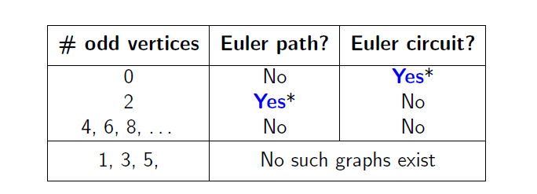
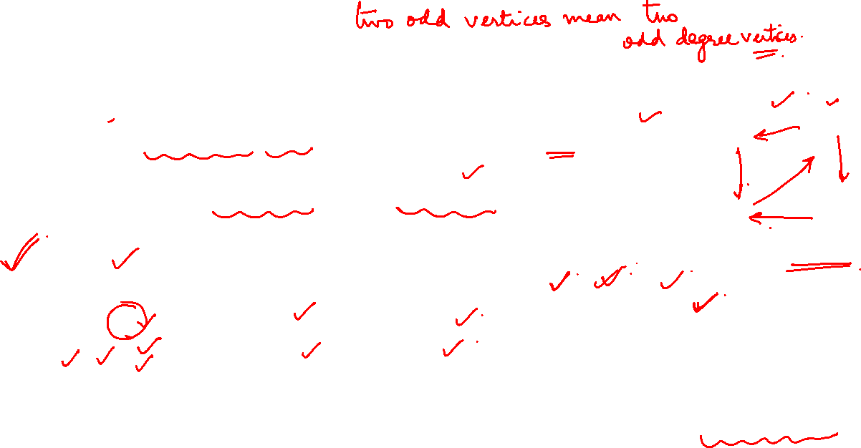
Graph Theory and its Applications Walk, Path, circuits
Is it possible to determine whether a graph has an Euler path or an Euler circuit, without necessarily having to find one explicitly?
If a graph G has an Euler path, then it must have exactly two odd vertices.
If a graph G has an Euler circuit, then all of its vertices must be even vertices.
Euler Circuit: A B C F E D A E C A

Slide 27
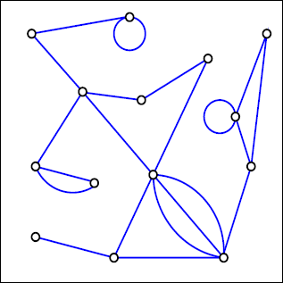
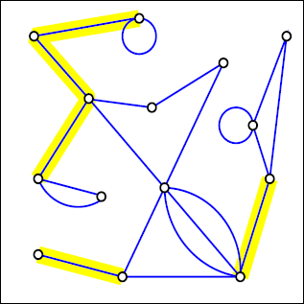
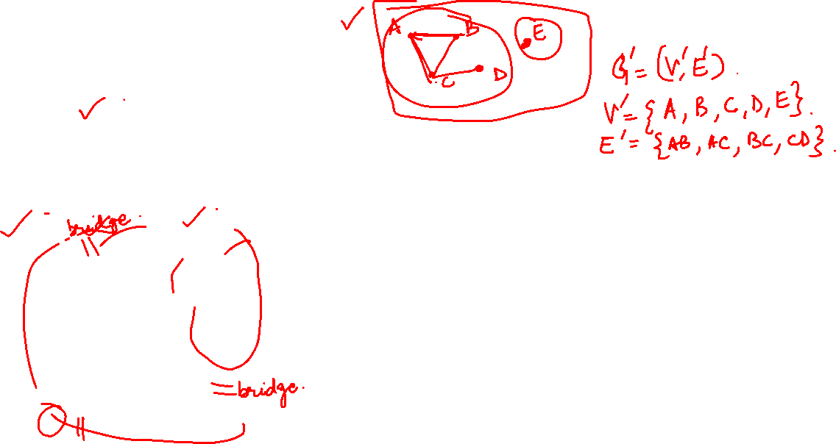
Graph Theory and its Applications Bridges
Bridges
Removing a single edge from a connected graph can make it disconnected. Such an edge is called a bridge.

Slide 28
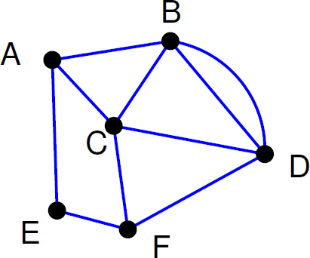
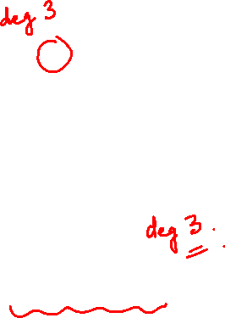
Graph Theory and its Applications Walk, Path, circuits
Find an Euler path in the graph below.
There are two odd vertices, A and F.
Let’s start at F.

Slide 29
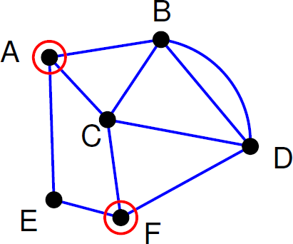
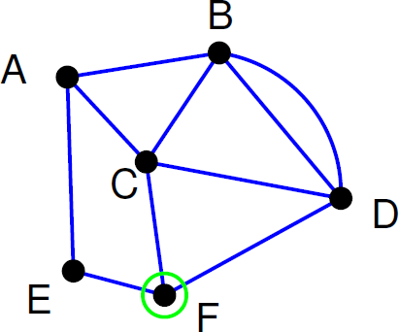
Graph Theory and its Applications Walk, Path, circuits
Start walking at F.
When an edge is traversed, delete it.

Slide 30
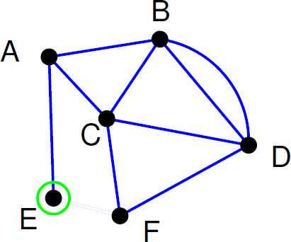
Graph Theory and its Applications Walk, Path, circuits
Path so far: FE

Slide 31

Graph Theory and its Applications Walk, Path, circuits
Path so far: FEA

Slide 32

Graph Theory and its Applications Walk, Path, circuits
Path so far: FEAC

Slide 33

Graph Theory and its Applications Walk, Path, circuits
Path so far: FEACB

Slide 34

Graph Theory and its Applications Walk, Path, circuits
Path so far: FEACB
Crossing the edge BA would be a mistake, because we would be stuck there. The reason is that BA is a bridge. Cross a bridge only if it is the only edge available

Slide 35

Graph Theory and its Applications Walk, Path, circuits
Path so far: FEACBD

Slide 36

Graph Theory and its Applications Walk, Path, circuits
Path so far: FEACBDC

Slide 37

Graph Theory and its Applications Walk, Path, circuits
Path so far: FEACBDCF

Slide 38

Graph Theory and its Applications Walk, Path, circuits
Path so far: FEACBDCFD

Slide 39

Graph Theory and its Applications Walk, Path, circuits
Path so far: FEACBDCFDB

Slide 40

Graph Theory and its Applications Walk, Path, circuits
Path so far: FEACBDCFDBA
Euler Path: F E A C B D C F D B A

Slide 41

Graph Theory and its Applications Walk, Path, circuits
Formally, a graph is Eulerian iff the following conditions are met:
The graph is connected.
Every vertex in the graph has an even degree (even number of edges incident to it).
If these conditions are satisfied, the graph has an Eulerian circuit, and it is an Eulerian graph.

Slide 42

Graph Theory and its Applications Walk, Path, circuits
Fleury’s Algorithm
Fleury's algorithm, (Eulerian path/circuit algorithm), is a graph traversal algorithm used to find Eulerian paths or circuits in a graph.

Slide 43

Graph Theory and its Applications Walk, Path, circuits
Fleury’s Algorithm
The graph must have either 0 or 2 odd vertices.
If there are 0 odd vertices, start anywhere. If there are 2 odd vertices, start at one of them.
Follow edges one at a time. If you have a choice between a bridge and a
non-bridge, always choose the non-bridge.
Stop when you run out of edges.

Slide 44


Graph Theory and its Applications Fluery’s Algorithm
Let us start the tour from vertex ‘2’.
There are two vertices with odd degrees, ‘2’ and ‘3’, and we can start paths from any of them.

Slide 45

Graph Theory and its Applications Fluery’s Algorithm
Three edges are going out from vertex ‘2’.
Let’s not pick the edge ‘2-3’ because that is a bridge. Let’s pick any of the remaining two edges.
Let us say we pick ‘2-0’. We remove this edge and move to vertex ‘0’.

Slide 46

Graph Theory and its Applications Fluery’s Algorithm
There is only one edge from vertex ‘0’, so we pick it, remove it and move to vertex ‘1’.
There is only one edge from vertex ‘1’, so we pick it, remove it and move to vertex ‘2’. Euler tour becomes ‘2-0 0-1 1-2’

Slide 47


Graph Theory and its Applications Fluery’s Algorithm
Again, there is only one edge from vertex 2, so we pick it, remove it and move to vertex 3. Euler tour becomes ‘2-0-1-2-3’
There are no more edges left, so we stop here. Final tour is ‘2-0-1-2-3’. ( Thus there is a Euler’s path 2-0-1-2-3)

Slide 48


Graph Theory and its Applications Walk, Path, circuits
Is the graph Eulerian?
f
a
b
g
d
c
h
e
Since all the vertices are having even degree and graph is connected, so graph is Euler graph.
Also, there exist a closed trail or Euler Circuit
$$f→a→b→g→c→h→b→c→d→a→e→d→f$$

Slide 49

Graph Theory and its Applications Walk, Path, circuits
Is the graph Eulerian?
Let’s Find a Euler Circuit!!

Slide 50
Graph Theory and its Applications Walk, Path, circuits
Is the graph Eulerian?

Slide 51
Graph Theory and its Applications Walk, Path, circuits
Is the graph Eulerian?

Slide 52
Graph Theory and its Applications Walk, Path, circuits
Is the graph Eulerian?

Slide 53
Graph Theory and its Applications Walk, Path, circuits
Is the graph Eulerian?

Slide 54
Graph Theory and its Applications Walk, Path, circuits
Is the graph Eulerian?

Slide 55
Graph Theory and its Applications Walk, Path, circuits
Is the graph Eulerian?

Slide 56
Graph Theory and its Applications Walk, Path, circuits
Is the graph Eulerian?

Slide 57
Graph Theory and its Applications Walk, Path, circuits
Is the graph Eulerian?

Slide 58
Graph Theory and its Applications Walk, Path, circuits
Is the graph Eulerian?

Slide 59
Graph Theory and its Applications Walk, Path, circuits
Is the graph Eulerian?

Slide 60
Graph Theory and its Applications Walk, Path, circuits
Is the graph Eulerian?

Slide 61
Graph Theory and its Applications Walk, Path, circuits
Is the graph Eulerian?

Slide 62
Graph Theory and its Applications Walk, Path, circuits
Is the graph Eulerian?

Slide 63
Graph Theory and its Applications Walk, Path, circuits
Is the graph Eulerian?

Slide 64
Graph Theory and its Applications Walk, Path, circuits
Is the graph Eulerian?

Slide 65
Graph Theory and its Applications Walk, Path, circuits
Is the graph Eulerian?

Slide 66
Graph Theory and its Applications Walk, Path, circuits
Is the graph Eulerian?

Slide 67
Graph Theory and its Applications Walk, Path, circuits
Is the graph Eulerian?

Slide 68
Graph Theory and its Applications Walk, Path, circuits
Is the graph Eulerian?

Slide 69
Graph Theory and its Applications Walk, Path, circuits
Is the graph Eulerian?

Slide 70
Graph Theory and its Applications Walk, Path, circuits
Is the graph Eulerian?

Slide 71
Graph Theory and its Applications Walk, Path, circuits
Is the graph Eulerian?

Slide 72
Graph Theory and its Applications Walk, Path, circuits
Is the graph Eulerian?

Slide 73
Graph Theory and its Applications Walk, Path, circuits
Is the graph Eulerian?

Slide 74
Graph Theory and its Applications Walk, Path, circuits
Is the graph Eulerian?

Slide 75
Graph Theory and its Applications Walk, Path, circuits
Is the graph Eulerian?

Slide 76
Graph Theory and its Applications Walk, Path, circuits
Is the graph Eulerian?

Slide 77
Graph Theory and its Applications Walk, Path, circuits
Is the graph Eulerian?

Slide 78

Graph Theory and its Applications Walk, Path, circuits
Theorem:
A connected graph G is Eulerian iff its edge set can be decomposed into cycles.
Proof:
Let G(V, E) be a connected graph and let G be decomposed into cycles.
If k of these cycles are incident at a particular vertex v,
then d( v)= 2k.
Therefore, the degree of every vertex of G is even and hence G is Eulerian.
Veblen's theorem states that the set of edges of a finite graph can be written as a union of disjoint simple cycles if and only if every vertex has an even degree - Oswald Veblen (1912)

Slide 79

Graph Theory and its Applications Walk, Path, circuits
Theorem : A connected graph G is a Euler graph iff all vertices of G are of even degree.

Slide 80

Graph Theory and its Applications Walk, Path, circuits
Theorem : A connected graph G is a Euler graph iff all vertices of G are of even degree.

Slide 81

Graph Theory and its Applications Walk, Path, circuits

Slide 82


Slide 83


Slide 84


Slide 85


Slide 86
Graph Theory and its Applications Walk, Path, circuits
Theorem : A connected graph G is a Euler graph iff all vertices of G are of even degree.
Sufficient:
Veblen's theorem states that the set of edges of a finite graph can be written as a union of disjoint simple cycles if and only if every vertex has an even degree - Oswald Veblen (1912)
G is a connected graph and each vertex of G has an even degree.
Hence, G contains many disjoint simple cycles.
The simple cycles are bound to have common vertices (As G is Connected)
The union of these disjoint cycles is nothing but a closed trail that traverses through all edges, an Eulerian Circuit
Hence the proof.

Slide 87


Graph Theory and its Applications Walk, Path, circuits
Euler Circuit in Directed Graphs
A directed graph has an Eulerian cycle or Eulerian circuit if following conditions are true:
All vertices with nonzero degree belong to a single strongly connected component.
In-degree = out-degree for every vertex.
Next is Hierholzer's algorithm for finding an Eulerian circuit
https://www.geeksforgeeks.org/euler-circuit-directed-graph/

Slide 88

Graph Theory and its Applications Walk, Path, circuits
Heirholzer’s Algorithm
This algorithm assumes that Eulerian graphs contain Circuits
Choose any starting vertex v, and follow a trail of edges from that vertex until returning to v. - Found one Circuit.
In this circuit, check for some vertex w where there is an unused edge.
Start from w and the unused edge starting from w start tracing a circuit until w is reached., taking care to explore new edges every time - Found another circuit.
Repeat the process until all edges are covered in one of the other circuits
Take the Union of all the circuits obtained and we get one Euler Circuit that touches all edges exactly once.

Slide 89




Graph Theory and its Applications Walk, Path, circuits
Heirholzer’s Algorithm
0—1—2– 0

Slide 90

Graph Theory and its Applications Walk, Path, circuits
Heirholzer’s Algorithm
0—1—2—0
1—3—4—1
Combine the two 0—1—(3—4—1)—2—0

Slide 91

Graph Theory and its Applications Walk, Path, circuits
Heirholzer’s Algorithm
a
a—b—c—a
b—d—c—e—d—b
Combine the two circuits
a—b—d—c—e—d—b—c—a
b
c
a—b—c—a
c—e—d—c
b—d—b
Combine the three circuits
a—b—d—b—c—e—d—c—a
d
e

Slide 92


Graph Theory and its Applications Walk, Path, circuits
Heirholzer’s Algorithm
1-2-3-4-5-6-1
6-7-2-6
On combining them, we get 1-2-3-4-5-(6-7-2-6)-1

Slide 93

Graph Theory and its Applications Walk, Path, circuits
Heirholzer’s Algorithm

Slide 94
Graph Theory and its Applications
How Hierholzer’s algorithm works?
Find a closed tour in a graph.
Start from any vertex v and follow a trail of edges until returning to v. The tour formed a closed tour.
2. Find branches
If there is a vertex u that belongs to the current tour, but that has adjacent edges not part of the tour, start another trail from u, following unused edges until returning to u.
3. Use backtrack to use all edges
Keep following unused edges and removing them when we get stuck. When stuck, backtrack to the nearest vertex in the current path that has unused edges. Repeat the process until all the edges have been used.
https://www.lavivienpost.com/hierholzers-algorithm-find-euler-path/

Slide 95

Graph Theory and its Applications Walk, Path, circuits
Heirholzer’s Algorithm

Slide 96




Graph Theory and its Applications Walk, Path, circuits
Heirholzer’s Algorithm
a _{a}
b
c
d
e
f
g
h
i
j
k

Slide 97

Graph Theory and its Applications Walk, Path, circuits
Heirholzer’s Algorithm

Slide 98

Graph Theory and its Applications Walk, Path, circuits
Which of the following graphs contain an Euler Trail/path? Which contain an Euler circuit?
For a graph to have an Euler circuit, all vertices must have even degree.
The converse is also true: if all the vertices of a graph have even degree, then the graph has an Euler circuit,
If there are exactly two vertices with odd degree, the graph has an Euler path.
K4 K5
Ans: K4 does not have an Euler path or circuit.
K5 has an Euler circuit, but not a Euler path.

Slide 99

Graph Theory and its Applications Walk, Path, circuits
Which of the following graphs contain an Euler Trail/path? Which contain an Euler circuit?
For a graph to have an Euler circuit, all vertices must have even degree.
The converse is also true: if all the vertices of a graph have even degree, then the graph has an Euler circuit,
If there are exactly two vertices with odd degree, the graph has an Euler path.
K5,7 does not have an Euler path or circuit.
K2,7 has an Euler path but not a Euler circuit.(If there are exactly two vertices with odd degree, the graph has an Euler path)
K5,7 K2,7

Slide 100

Graph Theory and its Applications Walk, Path, circuits
Which of the following graphs contain an Euler Trail/path? Which contain an Euler circuit?
C7 P7
For a graph to have an Euler circuit, all vertices must have even degree.
The converse is also true: if all the vertices of a graph have even degree, then the graph has an Euler circuit,
If there are exactly two vertices with odd degree, the graph has an Euler path.
C7 has an Euler circuit (it is a circuit graph!)
P7 has an Euler path but not a Euler circuit

Slide 101
Graph Theory and its Applications Questions
For what value of n does the graph K_{n} has an Euler Circuit?
K_{n} has a Eulerian circuit if the degree of each vertex is even.
This means n has to be odd since degree of each vertex in K_{n}=n-1

Slide 102

Graph Theory and its Applications
Walk, Path, circuits
For what values of m and n does the graph K_{m,n} contain a Euler path and a Euler circuit?
If m, n= even, then Km,n has an Euler circuit.
If m, n= odd, there is no Euler path or circuit.
If m= 2 and n=odd, then there is an Euler path but not an Euler circuit.

Slide 103
Graph Theory and its Applications Walk, Path, circuits
Q: Can Euler graph contain isolated vertices?
Ans: YES ( A Euler graph is a connected graph except for any isolated vertices the graph may have.)

Slide 104



















































Graph Theory and its Applications Eulers Digraphs

Slide 105




































Graph Theory and its Applications Eulers Digraphs

Slide 106
































































Slide 107

Graph Theory and its Applications Walk, Path, circuits
A bridge builder has come to Königsberg and would like to add bridges so that it is possible to travel over every bridge exactly once. How many bridges must be built?
If we build one bridge, we can have an Euler path. Two bridges must be built for an Euler circuit.

Slide 108




Graph Theory and its Applications Walk, Path, circuits
A bridge builder has come to Königsberg and would like to add bridges so that it is possible to travel over every bridge exactly once. How many bridges must be built?
If we build one bridge, we can have an Euler path. Two bridges must be built for an Euler circuit.

Slide 109
THANK YOU
Dr. Arti Arya
Department of Computer Science &Engineering
artiarya@pes.edu

